Slide 1
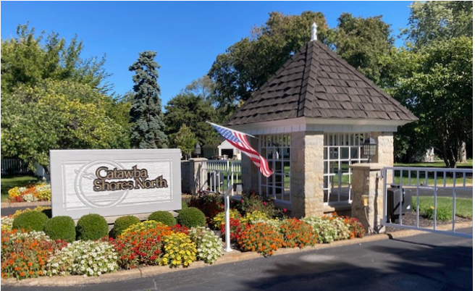
CSNCA Annual Meeting
September 9, 2023
Notes:
Line spacing + Page numbers

Slide 2
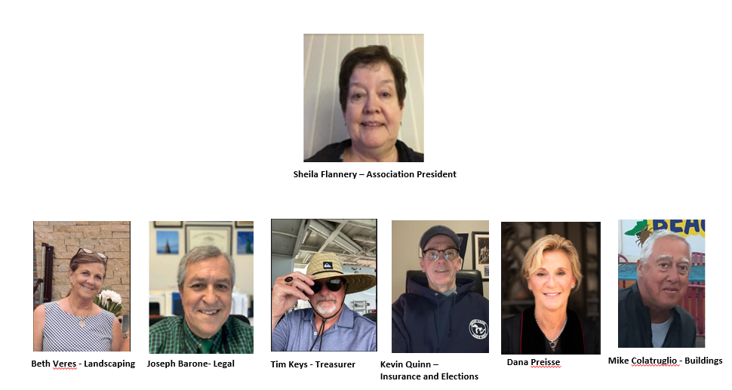
The Board’s Agenda
Agenda Items:
Welcome and Administration
Nominations & Voting for Board Members
Finance
  Balance Sheet
  Web Site Navigation
  Protecting Our Money
  Link to Construction Finance Summary
Buildings
Landscaping
Pool/Beach (Dana Unavailable)
Social & Communication
Legal/Special Projects
Questions and Answers
Adjournment of Meeting
Social Gathering Around CSN Pool Area

Slide 3
WELCOME AND ADMINISTRATION:
Welcome
Introduce Board Members
Approve FY22 Annual Meeting Minutes from Sept 10, 2022
Approve House Bill 135 Waiver – Waiver needs to be signed and turned into sign-in table

Slide 4
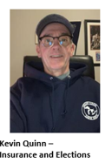
Voting for Board Members:
Explanation of Process
Introduction of Board Candidates
Vote

Slide 5
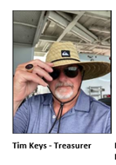
FINANCIALS:
Association Balances as of end of FY 22 (6/30/22)
  Reserves $ 112,659
  Operations $ 28,029
  1ST Nat Construction $ 125,319
  IntraFi Cash (ICS) $ 38,012
  CDARS $ 855,307
Review FY22 Actuals and FY23 Budget
Protecting Our Money - Explain IntraFi and CDARS

Slide 6
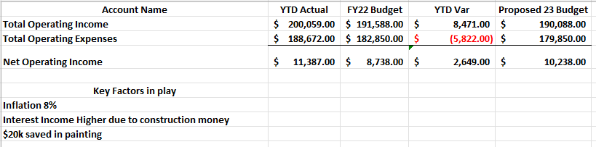
Annual Budget Comparison Between 2022 and 2023

Slide 7
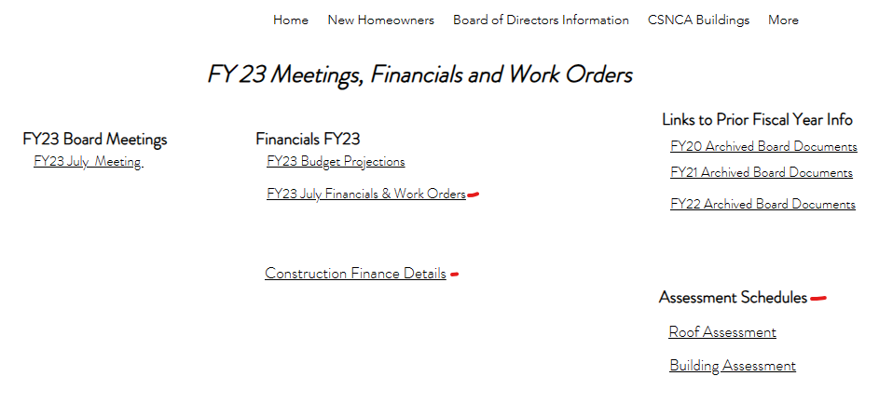
To Access Financials from our www.csnca.net
Hit “Board of Directors Info” link
Hit “Meetings, Financials and Work Orders” link
Type in Password = L@k3T1me
Password = L@k3T1me

Slide 8
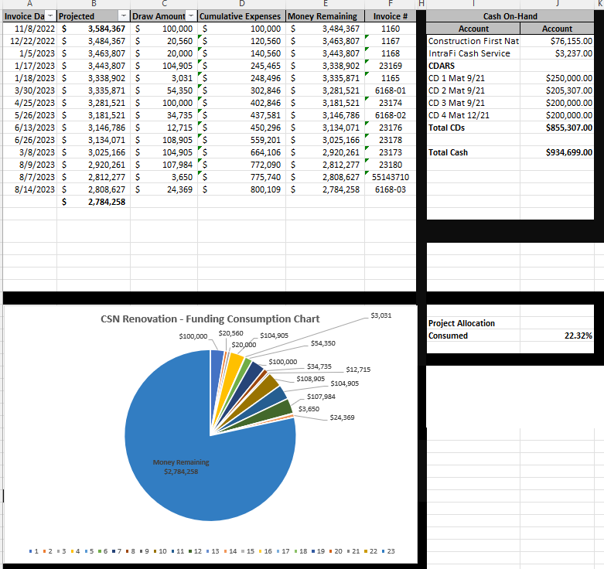
Current
Construction
Finance Details

Slide 9
Protecting Our Money
IntraFi Cash Service (ICS) and Certif of Deposit Account Registry Service (CDARS)
  Assessment collections caused our First National Bank balance to exceed the $250k FDIC limit
  Silicon Valley Bank and First Republic
  Board colleagues expressed concerns about FDIC limitations
  They asked to find a way to protect our money while yielding a competitive rate of return
  Meetings with President of 1st National where I expressed our concern
  This led our association to a service (ICS) that sweeps excess money from 1st National Bank into separate FDIC covered institutions. No one institution will ever exceed the $250k cap
  A second service called CDARS then allows us to transfer money from the ICS account into CDs. Again, no CD will exceed the $250k cap.

Slide 10







Start Here
CSN Construction Money gets collected
Money paid to contractor(s)
Money gets deposited at First National Bank into the CSN Construction Account
When the Construction Account exceeds $125k, that excess gets swept into a system called IntraFi Cash Services (ICS) which is supported by Bank of NY Mellon
When a draw is due to be paid to the contractor, money gets swept from ICS in reverse to replenish the FNB Construction Account
The ICS system then automatically distributes the money into accredited FDIC backed institutions never to exceed $250k
The ICS system then automatically distributes the money into accredited FDIC backed institutions never to exceed $250k
Most of the distributed money then gets converted to Cert of Deposits

Slide 11
ICS and CDARS Interest Income
Our plan is to use the interest income to pay for ancillary line items related to the construction project
New porch and deck stair stringers (Looking at steel stringers)
Address blocks
Flag holders
Walkway light fixtures
Walkway, porch and deck cement fixes
Drainage improvements (Especially front side of building 1)
Up-side deck ceiling
Garage gutters
B-Vent Replacement
Porch lights

Slide 12
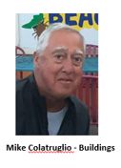
Debunking Myths Along the Way
Here we are in summer of 2022:
Tim It’s been said that people with increased responsibility (like CEO’s or U.S. presidents) rapidly age during their tenure. But Mike and I are here to tell you there is little evidence to support this belief.

Slide 13

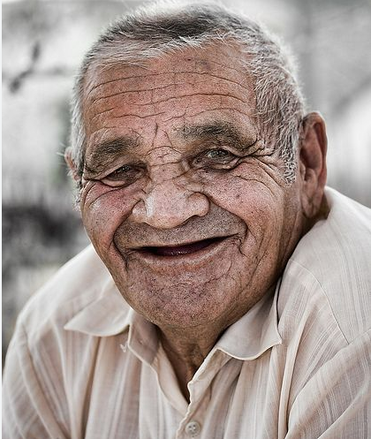
Debunking Myths Along the Way
Mike and Tim, summer of 2023:
Our appearance hasn’t changed 1 iota.
Tim

Slide 14
We wanted to stop the leaks
Eliminate as much as possible maintenance cost (painting)
Return this association back to its place of beauty and prominence in the Catawba community.
Defining the Mission – Important Objectives
Notes:
You can also add these lines. We have already tried big contractors, quick, fast and cheap and it has not worked. It has led to leaks, poor installation techniques and has slowed down progress for Ben and his crew as they attempt to provide quality renovation that will last for years. We want this done but more importantly we want it done right. We purposely did not include any dates in our contract because we did not want deadlines we want it done right. We also wanted the job done locally and done right.

Slide 15
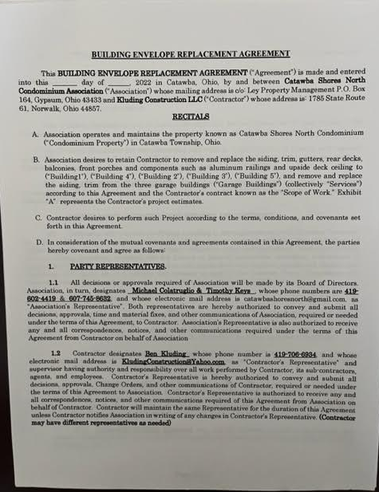
October 10 2022 – Contract is signed
Initial Steps to Move the Project Forward
Mike
Notes:
a. Some things we wanted in the contract- No dates or deadlines for finishing a building based on the principles that we had been told repeatedly by contractors that the buildings were full of leaks, needed structural renovation (no OSB) and required attention to detail. We were not looking for a quick fix or speed we want this project dome right.
b. The structure of payment was not based on hourly wages but rather on a draw system. The original fixed cost was based on a per building basis. Ben does not get paid until he needs a draw from the total allotment of the contract and that number is fixed. Therefore, our main focus is not with hours worked per week or whether or not he works a full Friday it is on meeting targets and reaching the goals of the renovation. Moving slowly or fast is not the primary objective, it is to fix the leaks, to get this project done right and make decisions that reflect sound business practices and futuristic implementation practices while maintaining our sense of Cape Cod beauty. Our motto is “Every day we fix another building leak is a good day”.

Slide 16
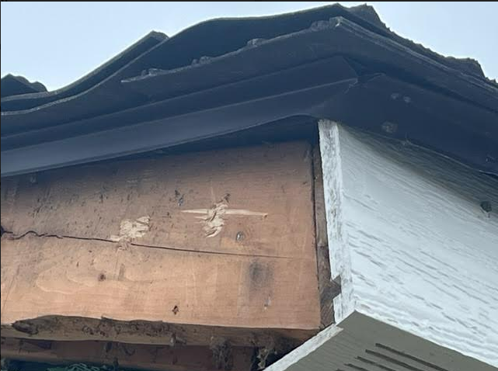
November 2022, Work Begins on Garages and Primrose
Notes:
a. Ben begins work on the garages. It was a good place to start. At that point we were all concerned with supply issues and how quickly they could be delivered. Threats of rail strikes and Covid had made it difficult to predict with certainty supply lines. We also have in the contract the ability to purchase materials at any point and get contract prices before hikes take place within the Diamond Kote company.

Slide 17
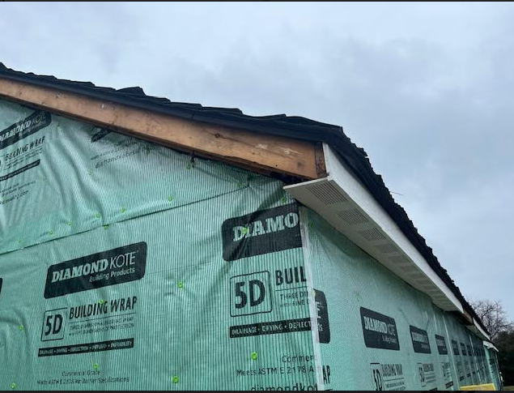
November 2022, Work Begins on Garages and Primrose

Slide 18
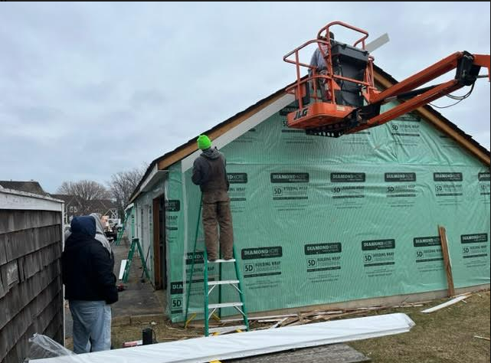
November 2022, Work Begins on Garages and Primrose
Notes:
b. First week in December as Ben is working on the trim of the south garage next to the dumpster he repeatedly expresses his frustration with the condition of the roof, the nailing process of the shingles and worry that
the siding will be fixed but that leaks very possibly could also be associated with the deterioration of the roof. Diamond Kote reps came on site and we all did a walk around the buildings trying to assess the condition of the
roofs. Ben did some research on the type of shingle and its performance particularly in this climate. The information coming back from all angles was not good. Ben’s men went up on the roof with the lifters and could see
areas of potential leaks primarily around the chimney that could effect all the warranties of the siding.

Slide 19
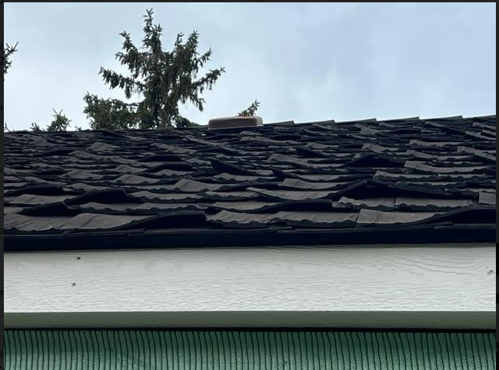
December - Roof Concerns Emerge
Mike 19
Notes:
c. Tim and I made an initial presentation to the Board on December 14 and told them we had to go down the rabbit hole once again to see what was needed. It was not what we wanted to do. Ben continued working on the
garages. We first went back and checked on the initial roofing and installation contracts. I remember climbing through PrimRose looking for pieces of the shingle and spending time on Google looking at the history,
reviews of the shingle and if any lawsuits had been filed. It became quickly apparent that we had major problems and we need to turn that part over to litigation and now focus on the question of repair or of getting a new roof.

Slide 20
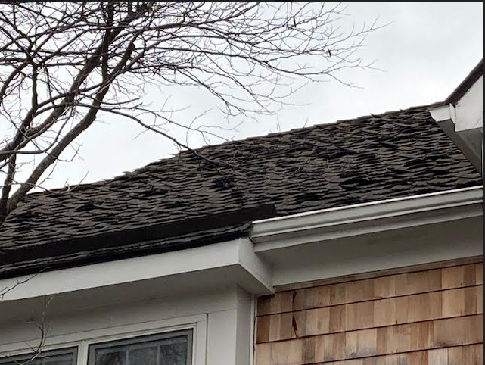
December - Roof Concerns Emerge
Mike 20
Notes:
I went to Modern Building Supply and Elyria supply companies I knew on Griswold Avenue to pick their brains on different types of shingles, company brands and warranties, It all pointed to CertainTeed as long as
they were 5 star rated distributors. December 23: Ben and I meet with our first roofing company Caldwell. It was my first introduction to Northgate shingle and why it was the fit for our climate. Over the course of the next 3
months Tim, Ben and I had numerous meetings in person and on the phone with roofing companies.

Slide 21
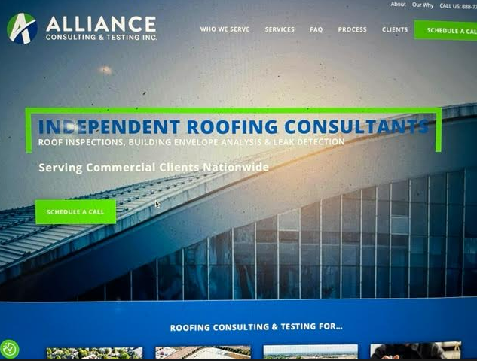
February – The Alliance Report gets Delivered confirms our concerns
Notes:
Tim Slide 21 (Slide of Alliance from website) In the meantime, the Board decided to hire an independent roofing consulting firm from Indianapolis (Alliance) to verify what our local roofing companies were telling us. We
wanted to make sure that this roof was not reparable and that the shingles needed to be replaced now. 21The report of Alliance verified are original findings – exposed fasteners from the curling shingles, chimneys with no water shield exposing
these areas to water intrusion, roof design issues that drain the water back into the chimneys and perforation of the metal valleys that could lead to leaks. In his summary statements, the President of the company Bill Harris
defined the shingles as defective.

Slide 22
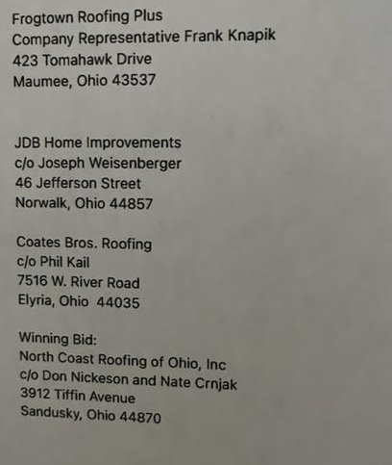
Interviewing roofing contractors, accepting bids and selecting North Coast
Mike 22
Notes:
Because Tim and I had done our homework, once we had these Alliance findings we were ready to move. We had studied GAF, CertainTeed, Corning and Scott brand of shingles, On March 20, the Board selected North Coast Roofing from the Sandusky/Castalia area out of 4 bids. Reasons included they were local, the owner is an engineer, references from property managers in Port Clinton/Marblehead area were very good and they could work with our contractor’s timeline.
Ben had another very valid reason, he asked if I looked at Nate’s fingernails - he said they were dirty, those were the hands of a working man not a salesman.

Slide 23
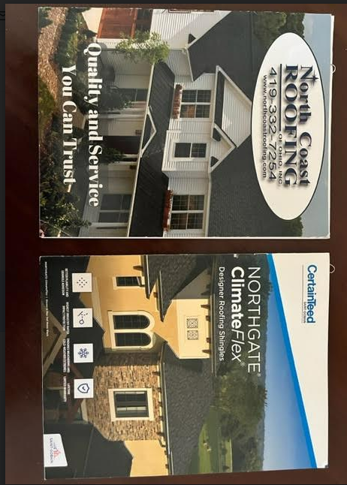
Interviewing roofing contractors, accepting bids and selecting North Coast
Notes:
There were 4 different CertainTeed shingles we honed in on - Landmark, Landmark Pro, Norhgate and Presidential. We settled on the Northgate because it offers rubber like qualities that improves resistance against hail
storms, cold weather flexibility and better granular adhesion. We received strong reference of it use in the cold of Northwest Ohio. CertainTeed offers a 25 year warranty on their product and we bought a 25 year labor warranty
to go with it. (Show the Pallet) choosing the color of the shingle was quite a process but it came down to 2 choices recommended by all the roofers of a deep black or the Driftwood we eventually chose. It was quite a Board
discussion and we looked at every angle. Our research and recommendations by the roofers we spoke with that when some shingles eventually need replacement, Moire Black would be harder to match the
color than with the multi color of a Driftwood. But is is like the Diamond Kote until you see it on the building you are very apprehensive of your choice.

Slide 24
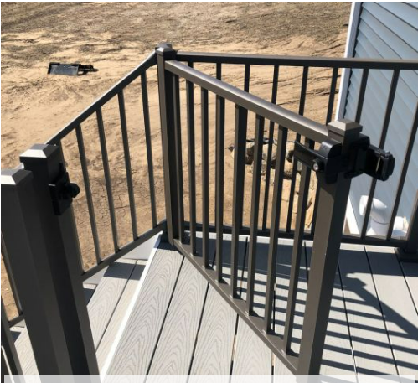
Other decisions that were made
Tim 24
Notes:
Development of plans for incidentals - Numerous meetings were held reviewing options availed for addresses, porch lights, flag holders, animal gates, front doors, storm doors and making the decision to put on a gutter system for the garages.
Even though Tim and I understand we were elected to make these decisions as representatives of the owners they represent what we do every week. (Show slide 25 for front doors) We try our best to gather the best possible information from every angle - owner input, pricing, supply list, references, gut instinct and what works best for the majority of the owners, we often find ourselves having to makes some decisions because Ben needs to know what to do now. That communication was very important to us when we talked about what we were looking for in the hire and now we feel good about why that was so important to us. This is very different from what you or even us would do if it was are own home.

Slide 25
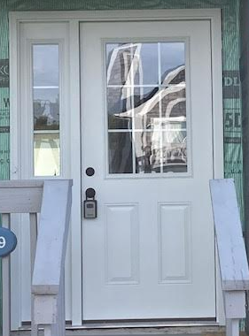
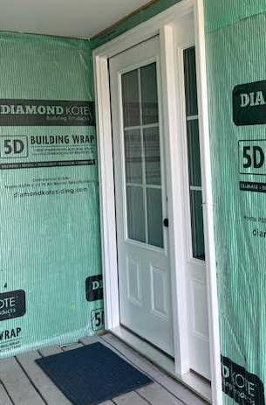
Other decisions that were made
Tim 25

Slide 26
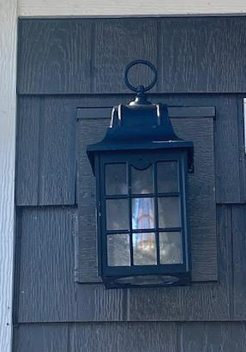
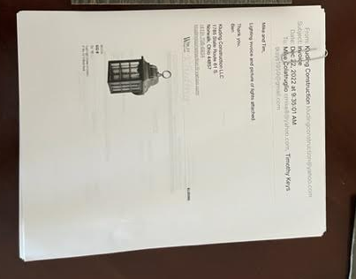
Other decisions that were made
Tim 26
Notes:
Sometimes we get feedback that an owner says they don’t like this detail or that look. There are somethings that I may not have done if it was my own home but we do what we think is right for the majority of the owners. Mike
- statement that I am sure some of you looked at the roof pallet and thought one of the other colors were interesting. We have that type of counter discussion all the time

Slide 27
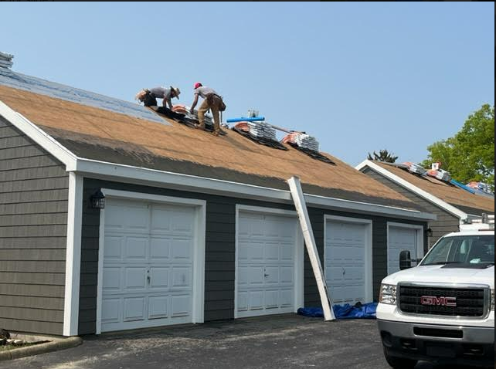
Replacing the roof
Notes:
(Slide of North Coast on roof) Installation of shingles on garages - just before Memorial Day weekend. Process went very smoothly and offered owners a glimpse of what the new roofs will look like on each building.

Slide 28
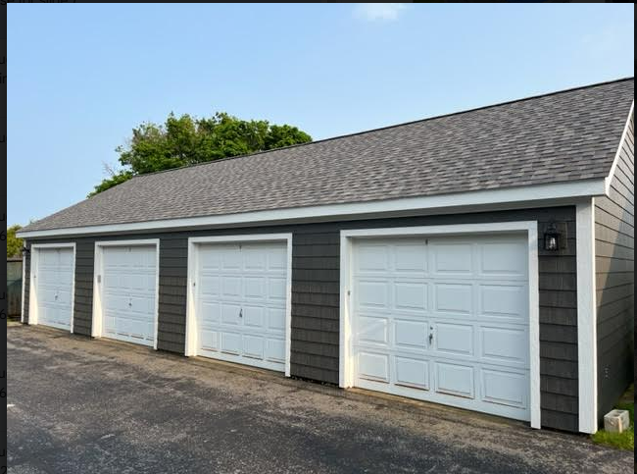
Replacing the roof

Slide 29
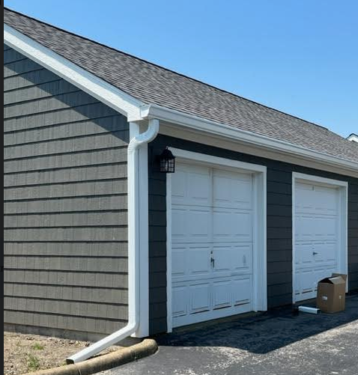
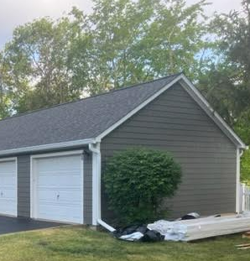
Gutter Install
Notes:
Early June - we just talked about making decisions - one such decision occurred in early June when Ben said he thought it was a good idea to install gutters on the garages. We quickly had email and phone conference as a Board and discussed the price and if it made sense. We decided that it made sense to have gutters installed. I remember very well the day the gutter guy Dave who will also be doing our buildings arrived. At the same time we were having trees trimmed off the north garages. Looking back we look like geniuses after 3 major storms. We still sustained some downspout and gutter damage.

Slide 30
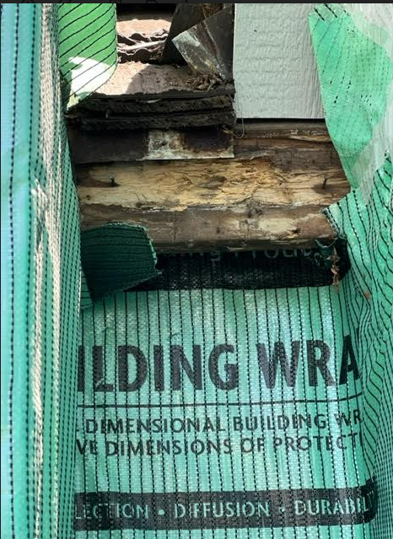
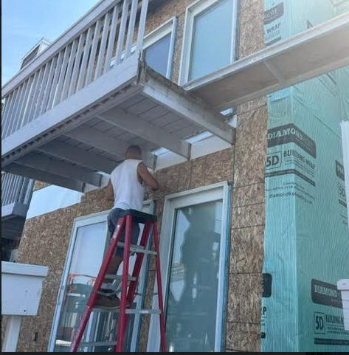
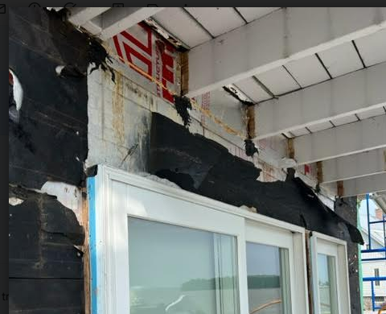
Building 1 - Lakeside
Notes:
What we learned from the lakeside - The issues we encountered were pretty much expected. Leaks were coming from old patio doors, half moon windows, improper flashing techniques and as I stated in the roof section
the chimney. Flashing has changed a lot over the years…I will let Ben speak to what he does. (slides) Replacement windows are another difference with Ben as oppose to replacement companies. If Ben has to
take time to flash properly you will receive an invoice for his time, materials and labor. We will tell you that upfront.

Slide 31
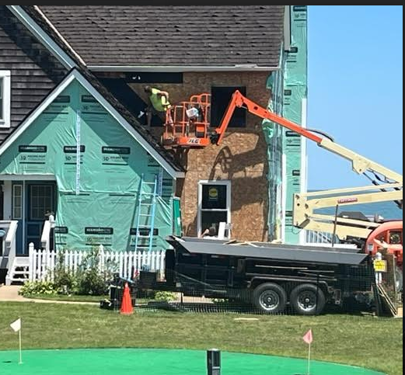
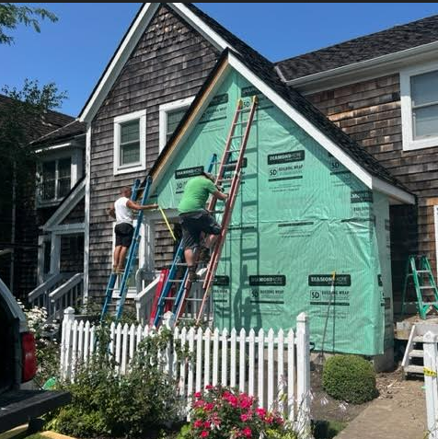
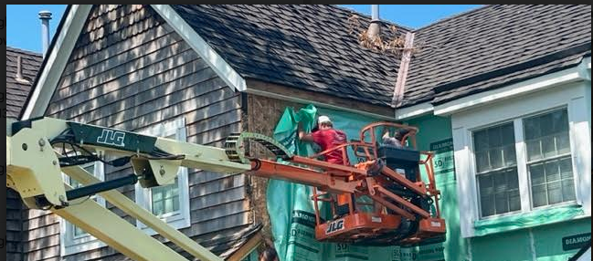
Building 1 – Common Side (Bee infestation)
Notes:
July was taking down the Common side and bees, hornets, and a Pepsi can. As we said before we understand this is a slow process but we want it done right. This Pepsi can Ben found while working on Beth’s roof edge is
the kind of attention to detail we want. Some contractors may have have just laughed and decided to leave it there for another 30 years.

Slide 32
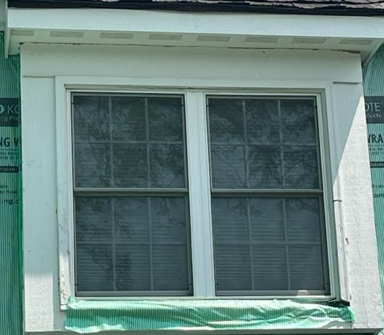
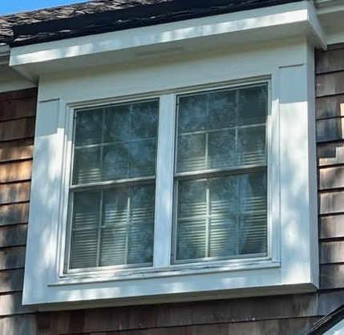
Building 1- Common Side
11
Notes:
Bay window in the middle of each building presented its own challenges. Issues associated with it is there is only one,the frame was not properly flashed and it is too big for the actual window. (Ben speaks to that)

Slide 33
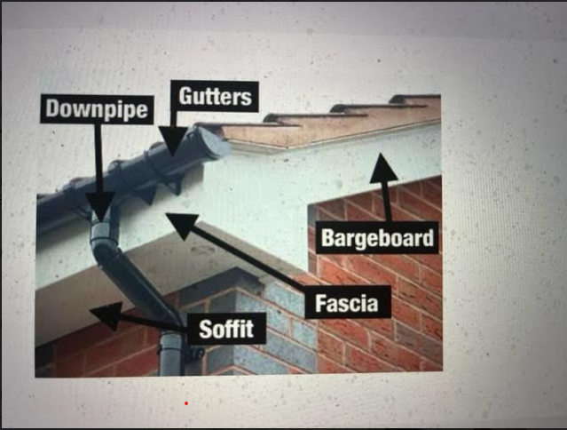
Building 1 - Roof
Mike 33
Notes:
Fascia The installation of the Building 1 roof took place early August after Ben had replaced the soffit and fascia. Ben had told us that the roof would come after he had done the soffit and fascia at the request of North Coast. You can expect us to follow a similar pattern from here on out.

Slide 34
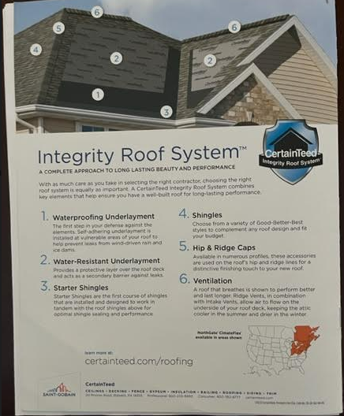
Building 1 - Roof
Mike 34

Slide 35
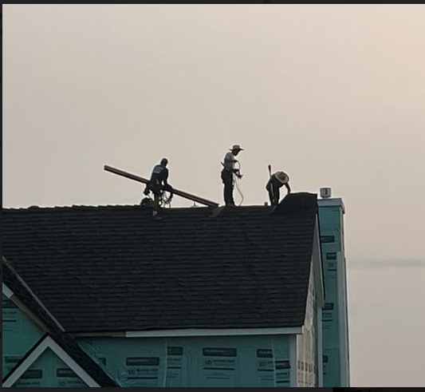
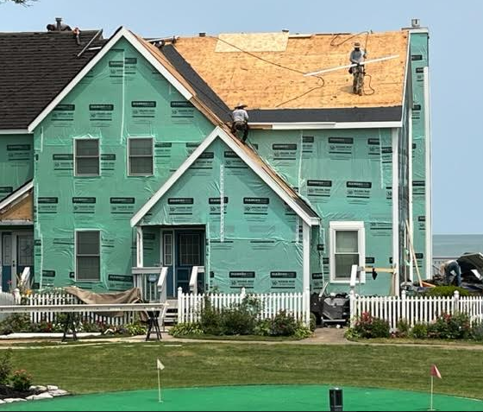
Building 1 - Roof
Mike 35

Slide 36
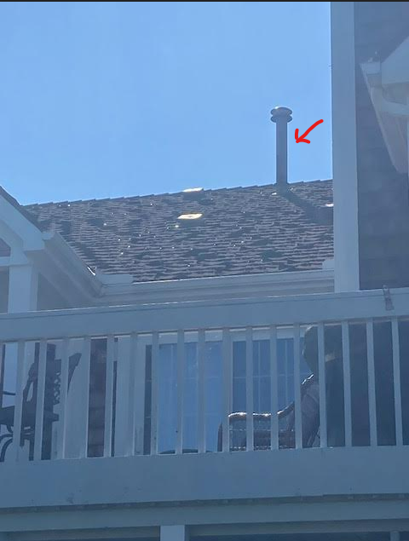
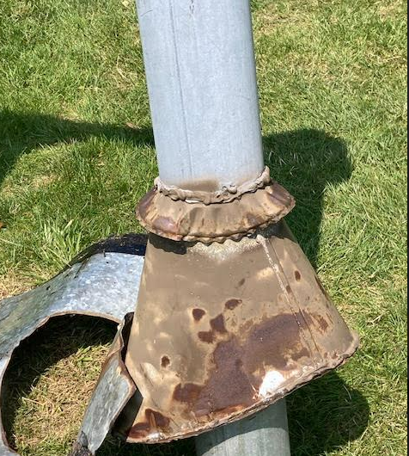
Building 1- Roof
Mike 36

Slide 37
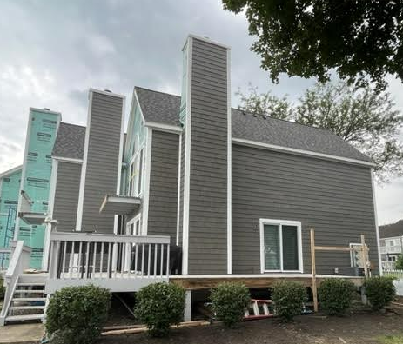
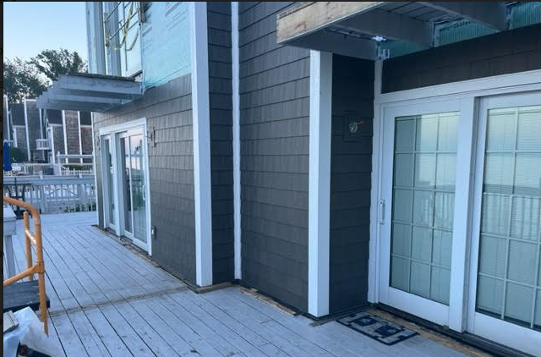
Building 1- Siding
Tim 37

Slide 38
We need to know what doors and windows should and must be replaced before building construction begins
We now have refined procedures for orders doors, windows and animal gates
We will have Ben install address blocks and flag holders and will evaluate, along with Diamond Kote experts and Ben, what other items can/should be fastened to the siding
Building 1- Learned Lessons from building 1
Mike 38

Slide 39
We expect the siding part of the renovation to be completed in about 5 weeks.
Decks will then be worked on and the expectation is that they can be completed by early November. That said, we don’t know what we’ll encounter with deck infrastructure.
We are studying the feasibility of implementing a plan of action that would help with the water runoff at Building 1. Building 3, 4, and 5 seem fine due to easy street drainage access. We have questions on building 2 as well. We are talking it over with Ben, Earl, the Board and area professionals.
Building 4 will be next
Future Expectations
Tim/mike 39

Slide 40
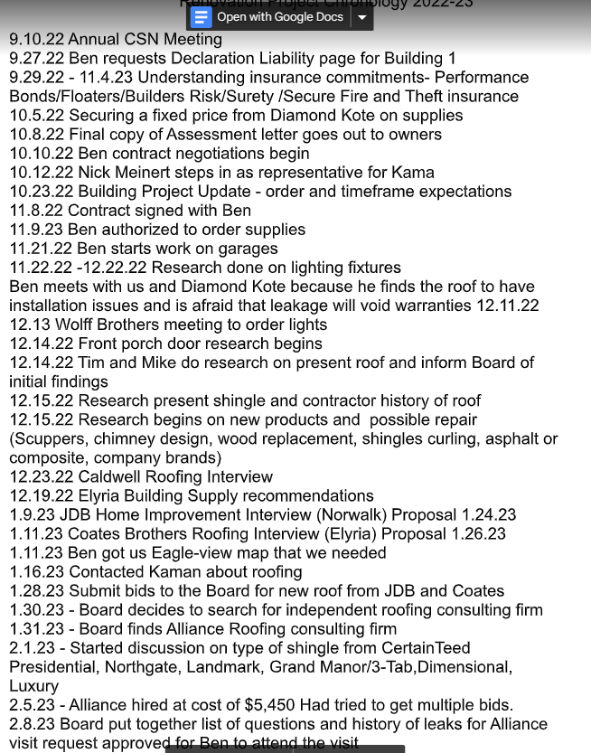
What has the Board been doing over the last year?
Tim/mike

Slide 41
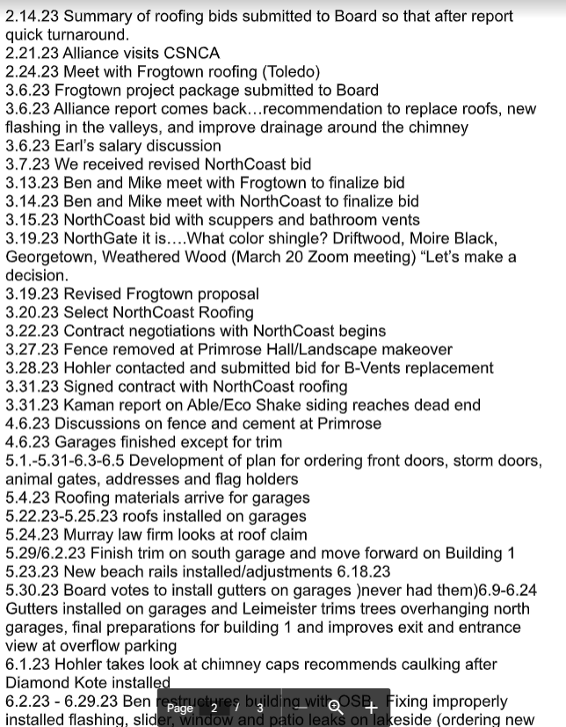
What has the Board been doing over the last year?
Tim/mike

Slide 42
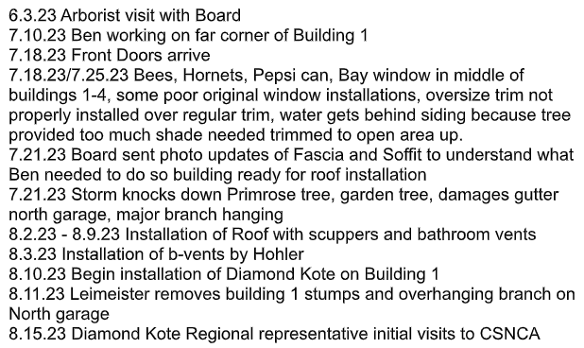
What has the Board been doing over the last year?
Tim/mike

Slide 43
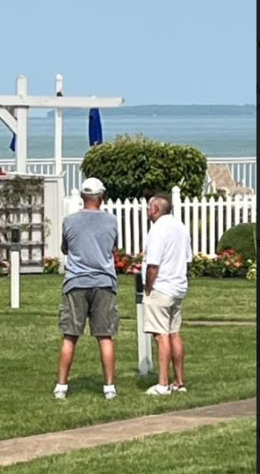
Thanks to our community members for your continued support!

Slide 44
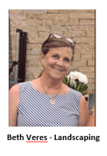
LANDSCAPING:
Introduce Committee Members
Landscaping update for FY 2023
Tree Trimming
Some Plans for 2023
lawn & ground maintenance update

Slide 45
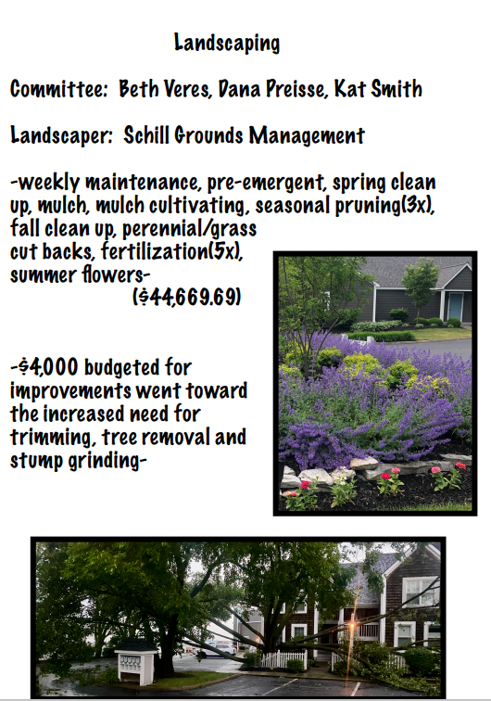
Landscaping
13

Slide 46
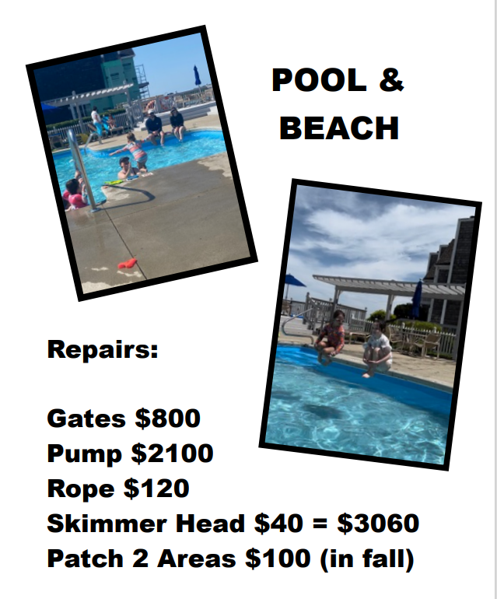
Pool
13

Slide 47

SOCIAL & COMMUNICATION:
Newsletter, Website, Membership Directory, Building Restoration Open House at Primrose
LEGAL/SPECIAL PROJECTS:
Leash and Amendments

Slide 48
QUESTIONS & ANSWERS
ADJOURNMENT OF MEETING

